Slide 1
Streamlining Shopping: The Online Grocery Order System
Presented by
D.GANGADHARA REDDY(192210597)

Slide 2
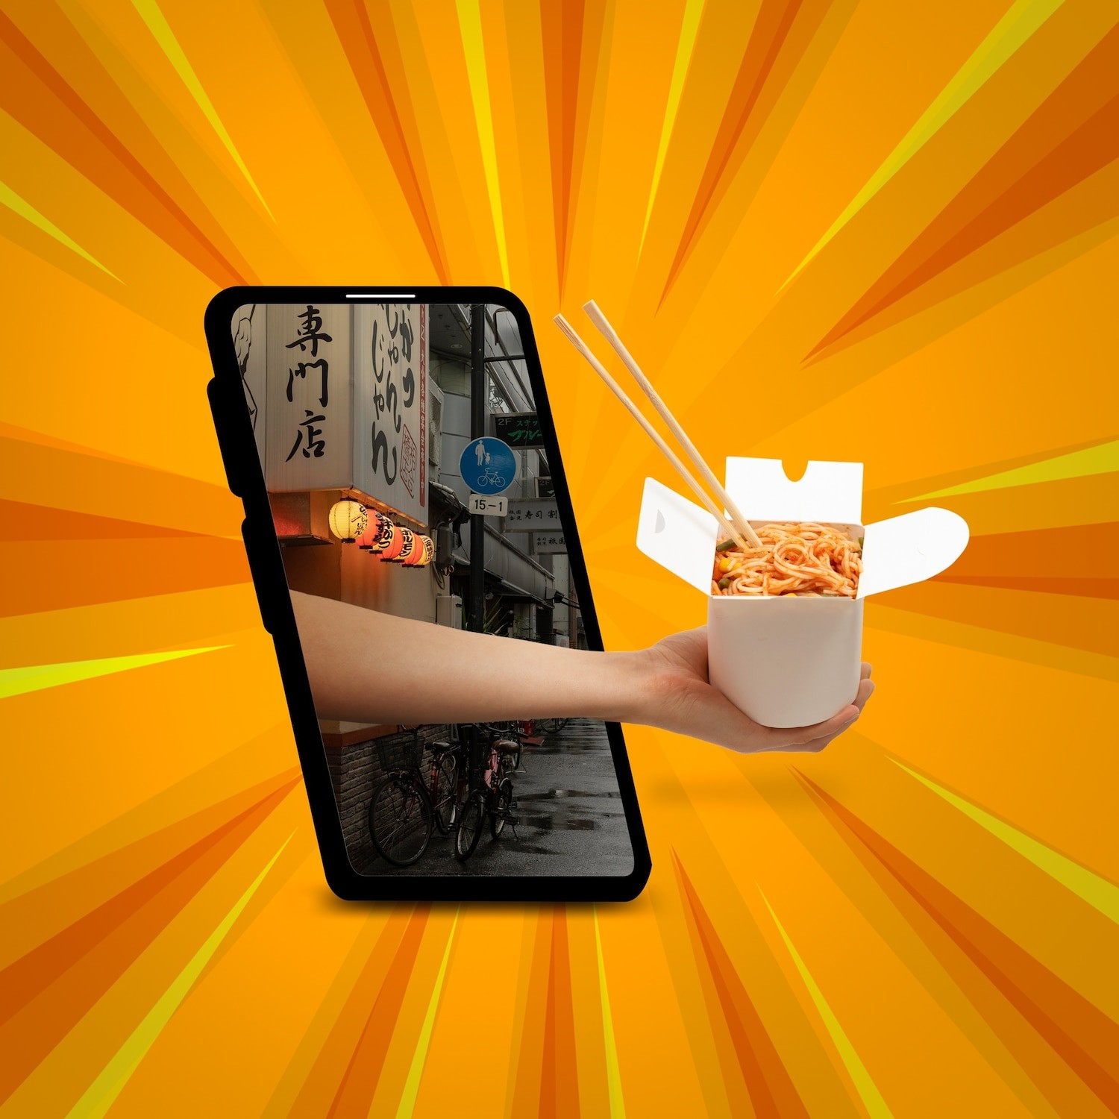
Introduction
In today's fast-paced world, online grocery shopping is becoming increasingly popular.
This presentation will explore the beneﬁts and challenges of the online grocery order system and provide insights into how it can be streamlined for a seamless experience.

Slide 3
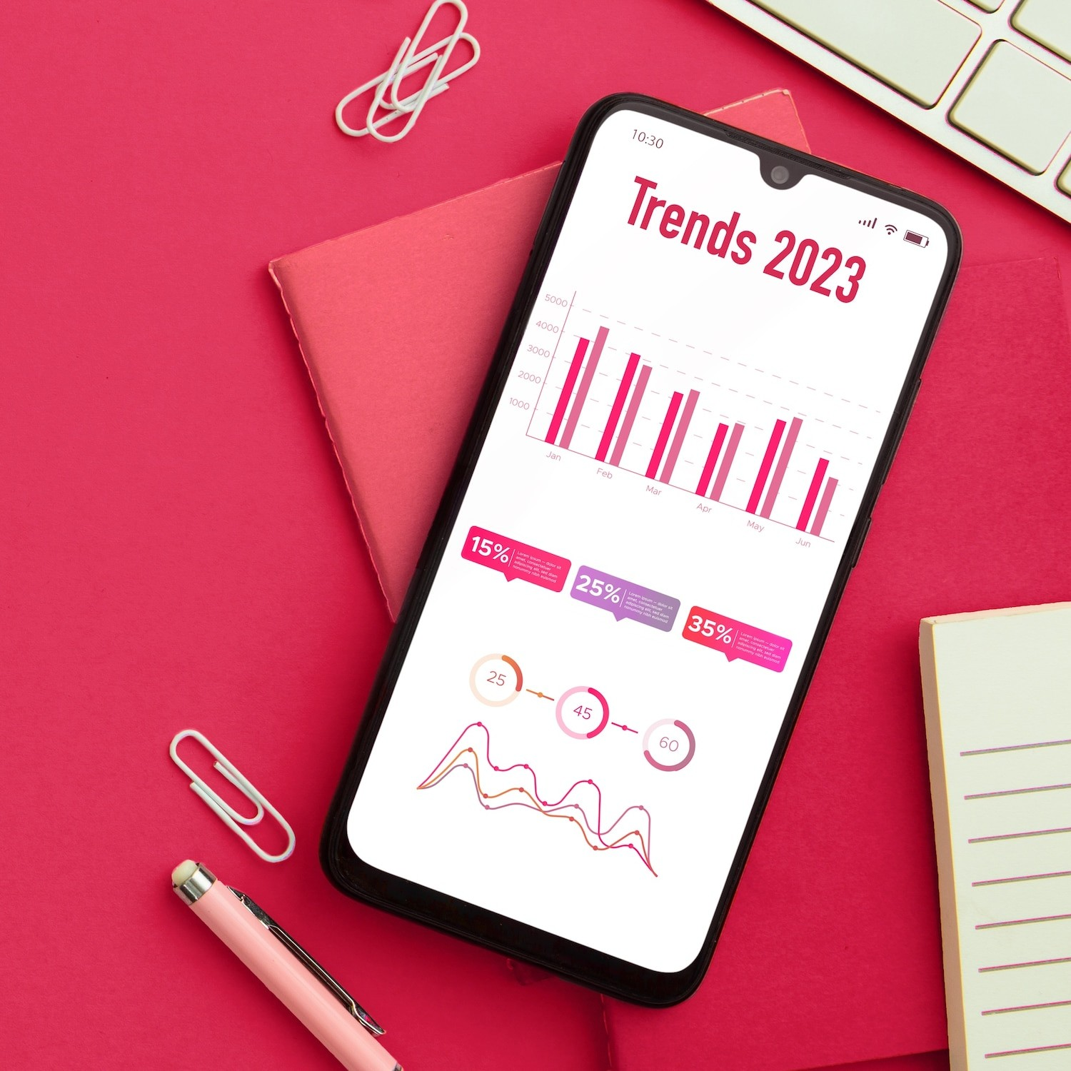
Rise of Online Grocery Shopping
The online grocery market has experienced exponential growth, driven by convenience and changing consumer behaviors.
With the increasing demand for online grocery orders, it's essential to optimize the shopping process to meet customer expectations and ensure efﬁciency.

Slide 4
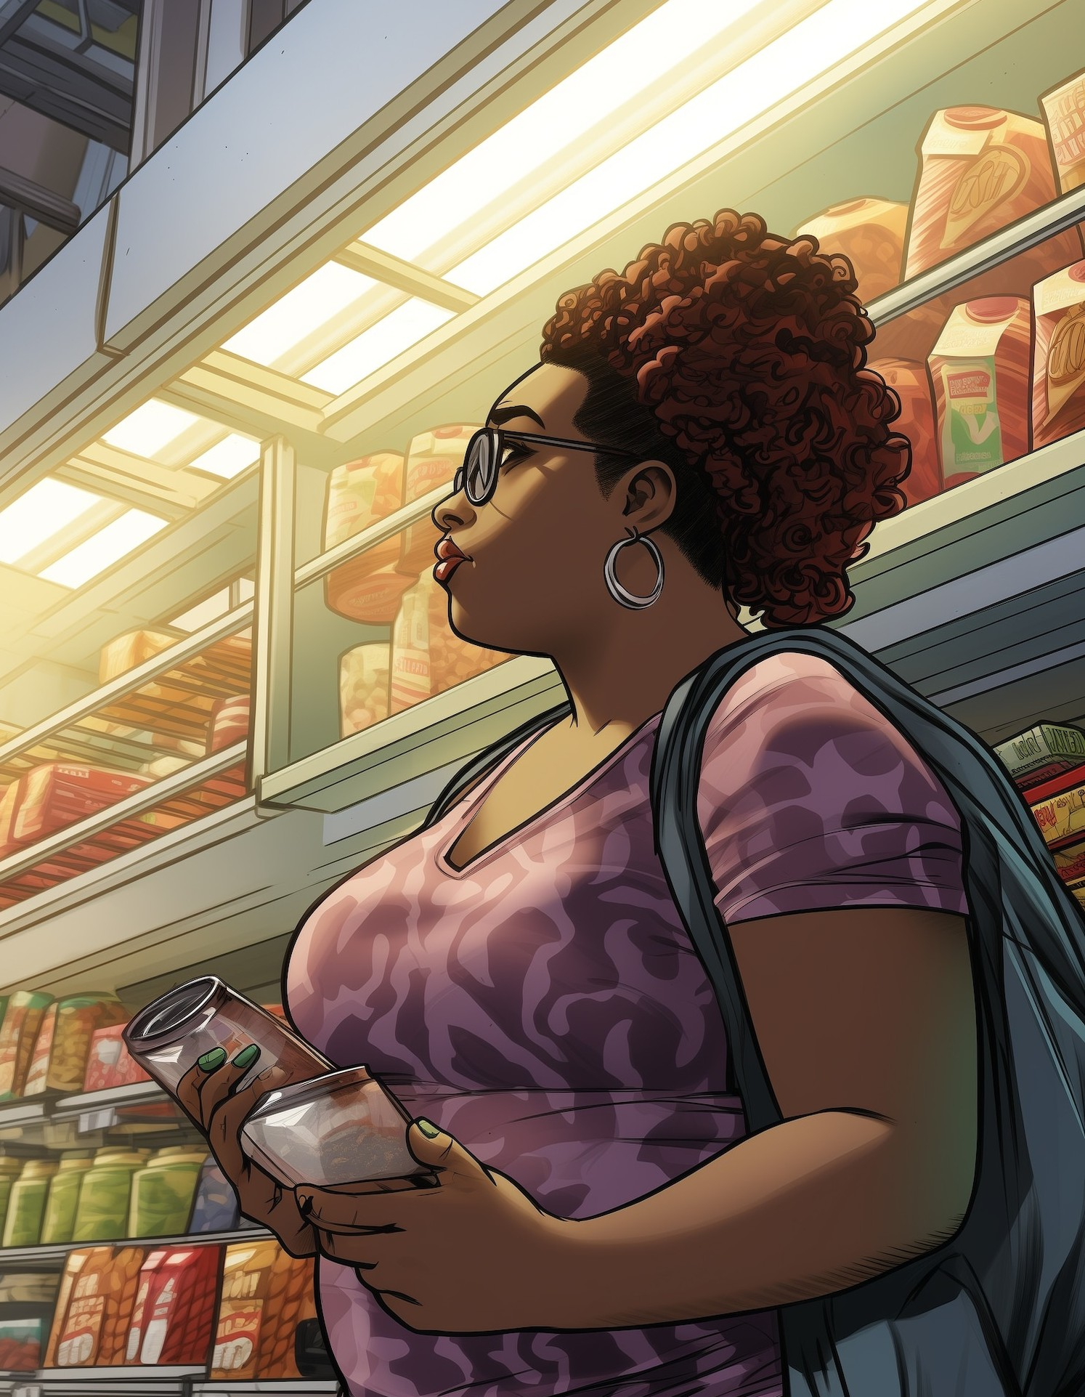
Challenges in Online Grocery Ordering :
While online grocery shopping offers convenience, challenges such as accurate inventory management,
delivery logistics, and customer satisfaction need to be addressed.
Overcoming these obstacles is crucial for a seamless online grocery order system.

Slide 5

Optimizing Inventory Management:
Effective inventory management is vital for online grocery retailers to ensure product availability, reduce out-of-stock instances, and maintain fresh stock.
Leveraging advanced technologies and data analytics can enhance inventory optimization and streamline the shopping process.

Slide 6

Efﬁcient Delivery Logistics :
Streamlining delivery logistics is essential for timely and accurate order fulﬁllment.
Utilizing route optimization, real-time tracking, and efﬁcient delivery networks
the online grocery order system, ensuring prompt and reliable deliveries

Slide 7

Prioritizing customer satisfaction through personalized recommendations, responsive customer support, and convenient order customization is crucial for a successful online grocery order system. Creating a seamless and enjoyable shopping experience is key to retaining loyal customers.

Slide 8
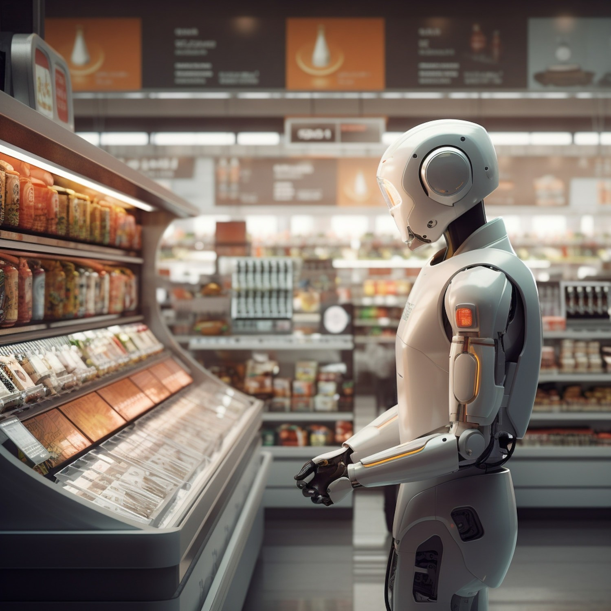
Future Trends in Online Grocery Shopping :
The future of online grocery shopping will likely see advancements in automation, sustainable practices, and innovative delivery solutions.
Embracing these trends will further streamline the online grocery order system and cater to evolving consumer preferences.

Slide 9

Conclusion:
Streamlining the online grocery order system is essential to meet the growing demand for convenient and efﬁcient shopping experiences.
By addressing challenges, optimizing processes, and embracing future trends, online grocery retailers can create a seamless and rewarding shopping journey for customers.

Slide 10
Thank you

